Slide 1

Multilateral Moneyball

Slide 2

The Inspiration
Notes:
How to make this more engaging:
Start with the idea of moneyball
Diplomacy is an art. Is there room for data?
Moneyball: Baseball for generations has also been an art. Moneyball showed us that data can be used to improve even further .
State knows the art of diplomacy. They know what’s important and how to do their job well. Imagine if we can answer their questions with the click of a button
State came to us with this challenge.

Slide 3
State Department Requests
Data Visualization Tools
G77 Bloc Dynamics
BRICS
Post-2015 Development Goals
Notes:
“Data Visualization—
How can project findings/outcomes be captured in visualization tools for senior policymakers and field negotiators?”
Demarche Tracker and Data Miner—
Create a system, database architecture, and interface to capture, search, and analyze diplomatic interactions related to requests for support on multilateral initiatives.”
G-77 Bloc Dynamics –
A current project is examining changes in the cohesion of the G-77 over time and across issue areas. The project has identified (1) “typical defectors” in each region and (2) the possible emergence of informal sub-blocs that show higher internal cohesion (i.e., SIDS and “radicals”). Possible extensions of this project include:
- In-depth analysis of “typical defectors.” What guides their decision to stick with their bloc or defect (i.e., issue area, diplomatic pressure, etc.)? What effect do their decisions have on regional partners and allies?
Impact of informal sub-blocs. What effect do they have on overall G-77 behavior? Do they lead G-77 in some areas a/o break G-77 in other areas?
BRICS in the G-77 and in the Post-2015 Debate –
What role can we expect the BRICS to play within the G-77 and especially in the upcoming Post-2015 Debate? On issues where middle-income country interests diverge from developing countries, will they break with the G-77, follow them, or lead them in a new direction? What are the prospects for internal cohesion and messaging discipline among the BRICS?

Slide 4
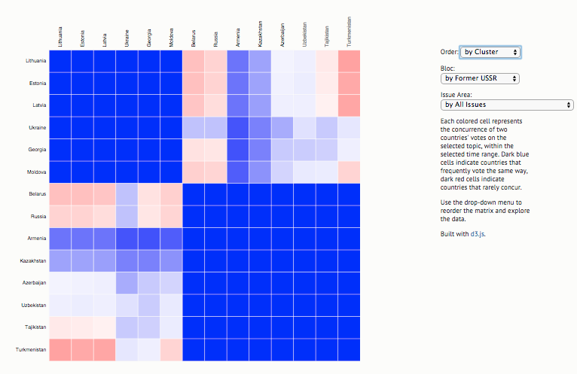
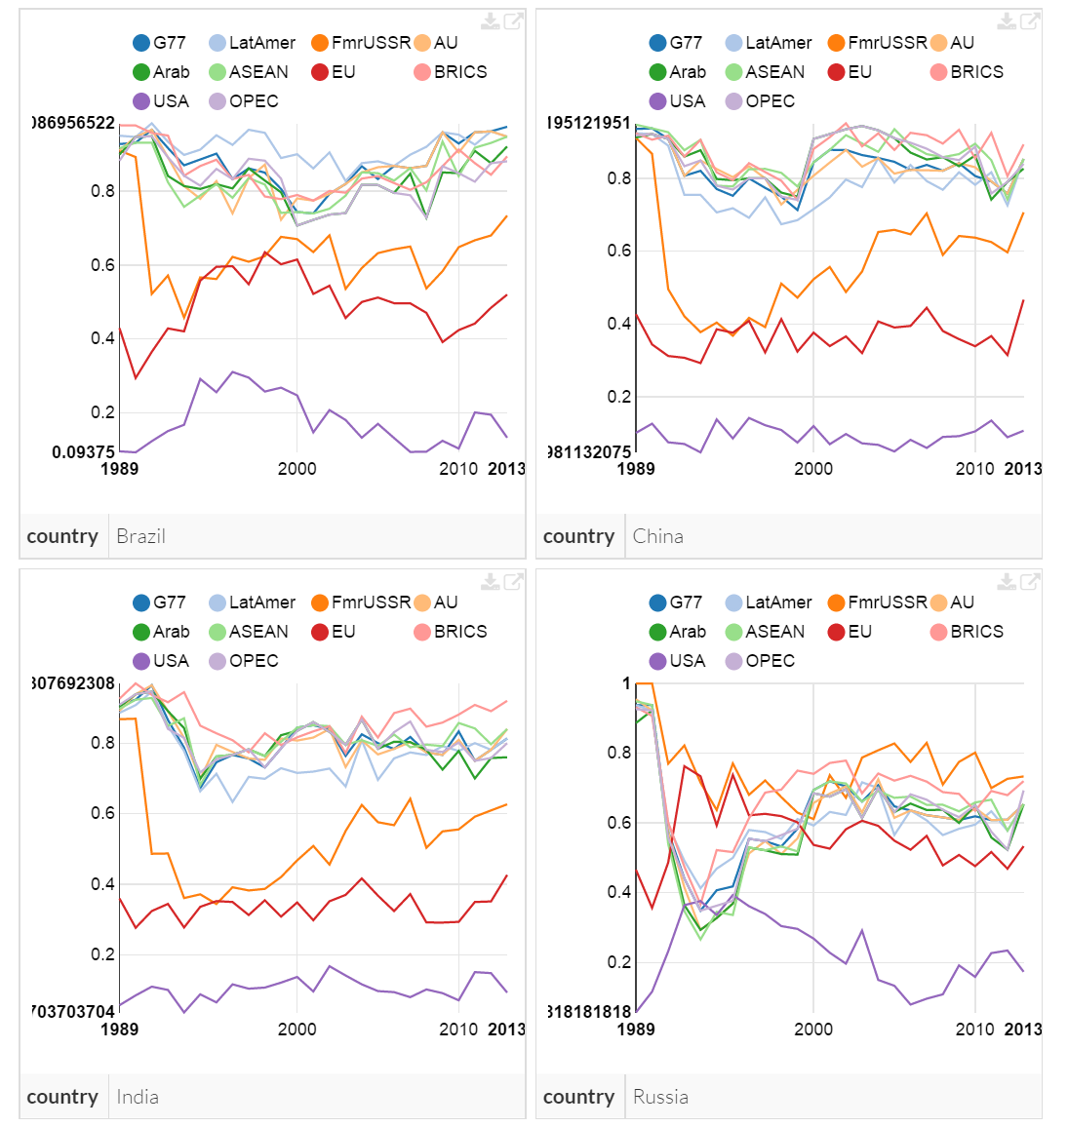
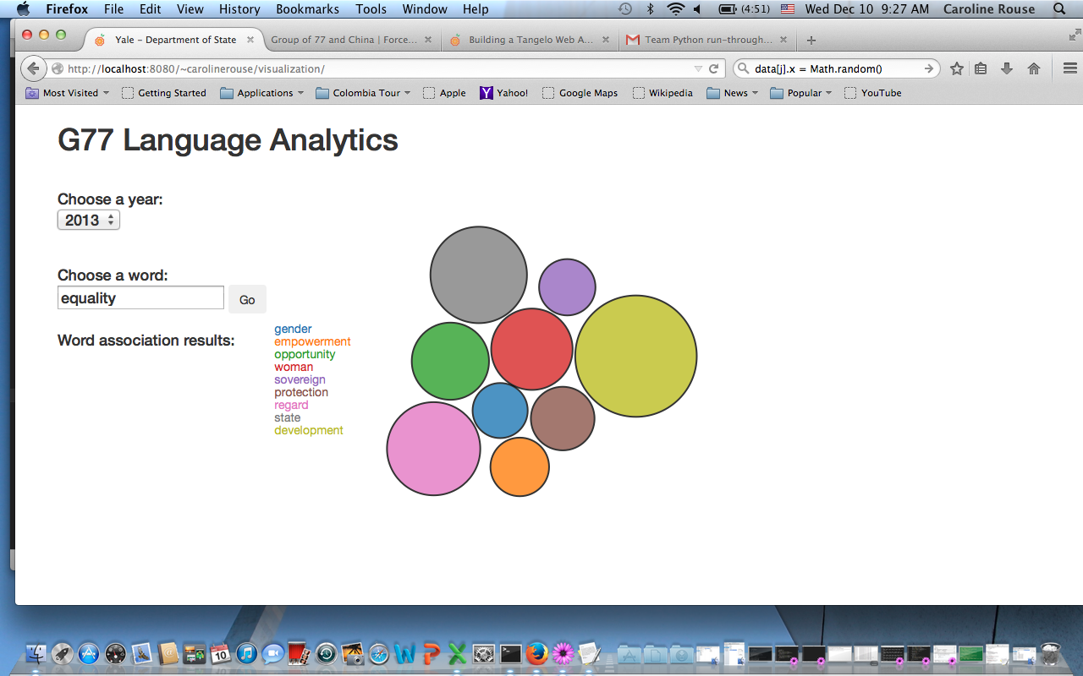
Overview of Web Apps
1
2
3
Notes:
Name the tools, but don’t describe them. Just say that we have used both traditional and innovative data.
Voting Cohesion Matrix
Trelliscope Display
Text Analysis

Slide 5
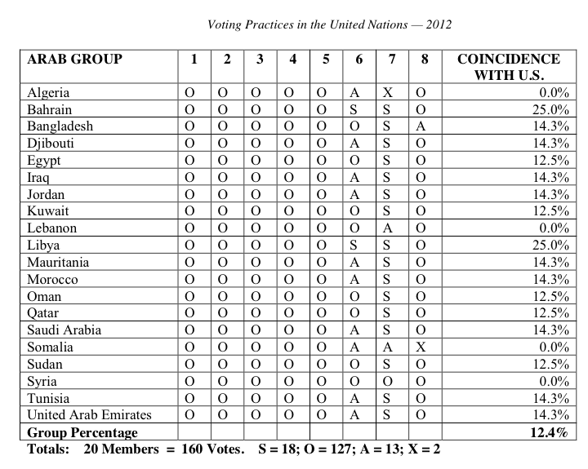
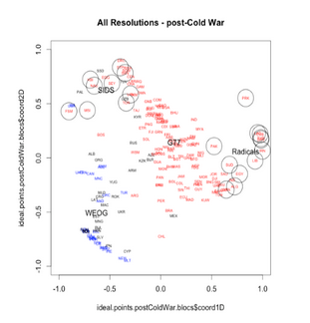
Previous Uses of Votester Database
Annual Voting Practices in the UN Report
Moneyball (Summer 2014)

Slide 6
Cohesion Matrix & Trelliscope
1
Construct relevant clusters of countries for analysis from Votester data
2
3
4
Utilize existing records of country votes in the United Nations (Votester)
Identify filters of interest for group cohesion e.g.:
-Blocs
-Issue Areas
-Time
Display data in dynamic voting cohesion matrix and trellis displays
Both tools are accessible online and can be filtered in real-time
Notes:
not just analysis but active tools - forward uses

Slide 7
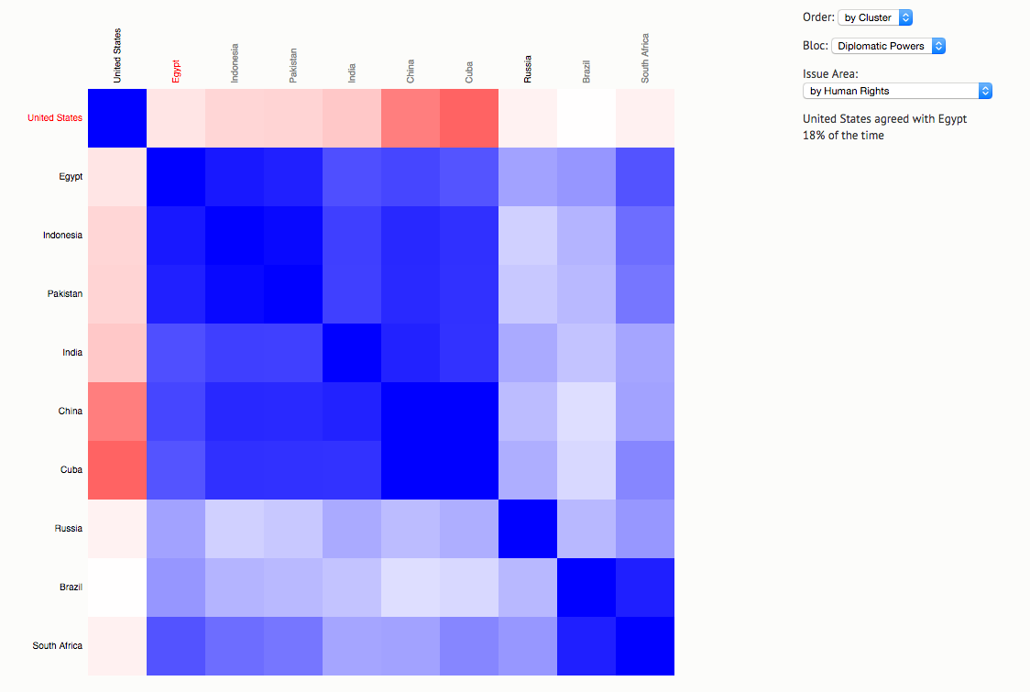
Cohesion Matrix
Color:
Dark blue signals complete agreement
Dark red signals complete disagreement
Clustering:
Statistical frequency of voting cohesion
ec2-54-69-111-237.us-west-2.compute.amazonaws.com
Notes:
Matrix displays cohesion between selected countries based on historic voting data
-Countries are grouped together based on history of voting together.
-The color of the squares is determined by the average concurrence between the two countries, with darker blues signifying more agreement and darker red displaying greater disagreement.
-As you can see in this example, we have constructed a study group of countries based on our conversations with State in September. By applying our visualization technique, we can quickly identify cohesive sub-blocs who have a history of voting together.
-These darker blue blocks will be seperated by lighter colored of even red bands, as shown here with a bloc of Asian players, as well as Cuba and Egypt, who seem to vote together more cohesively

Slide 8


Slide 9
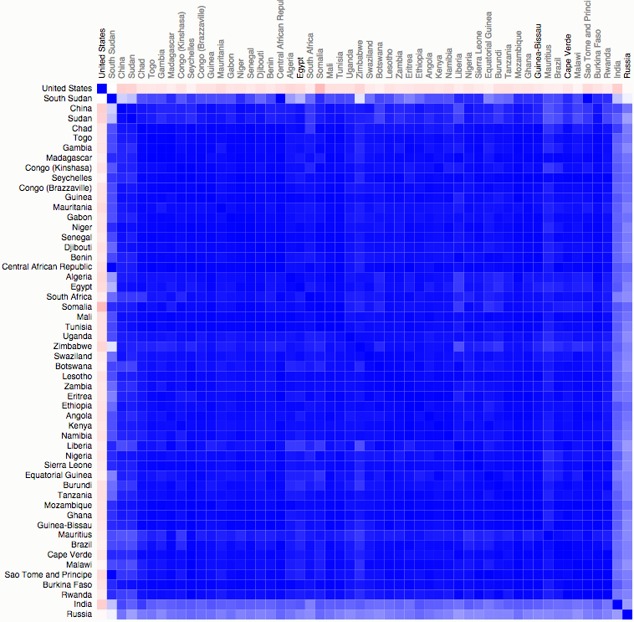
Cohesion Matrix: African Union + BRICS
Notes:
Countries are clustered together based on historic number of cohesive votes, allowing you to visualize sub-blocs and potential spheres of influence
Lighter bands of color represent weaker cohesive ties - potential defectors from their bloc
-On the left we see the African Union that divides into 4 sub-blocs based mostly on regional lines. South Sudan is an interesting anomaly, but this is attributed to the lack of historic data for this country
-On the right, we add in BRICS and due to our clustering method, we see the arrangement of countries based on historic frequency of voting.
-As such, we can see that the US stands alone against all other countries in the block as signified by the red streak.
-Then we see a bloc that hosts China that could signify their sphere of influence in the AU
-South Africa has its own distinct sub-bloc
-Brazil has a distinct sphere of influence as outlined in the lower right box
-What is interesting is that we can clearly see that India and Russia have a much more limited influence on African Union voting patterns,
Issue with Cohesion is that we are looking at an average snapshot, and we need to using the Trelliscope display to examine each of the BRICS countries more closely and better understand their influence or concurrence on the Afrian Union block
SPLIT INTO 2 SLIDES

Slide 10
Trelliscope
Flexible data visualization platform developed by DARPA
Dynamic, multi-panel viewing
Sort & filter through data to identify trends
http://yalestateengagement.shinyapps.io/YaleStateTrelliscope
Username: DoS
Password: yalestateengagement
Notes:
“The strength with cohesion matrix is ____. With Trelliscope, you can view dynamic bloc trends over time, understanding both past and present country voting behavior.”

Slide 11
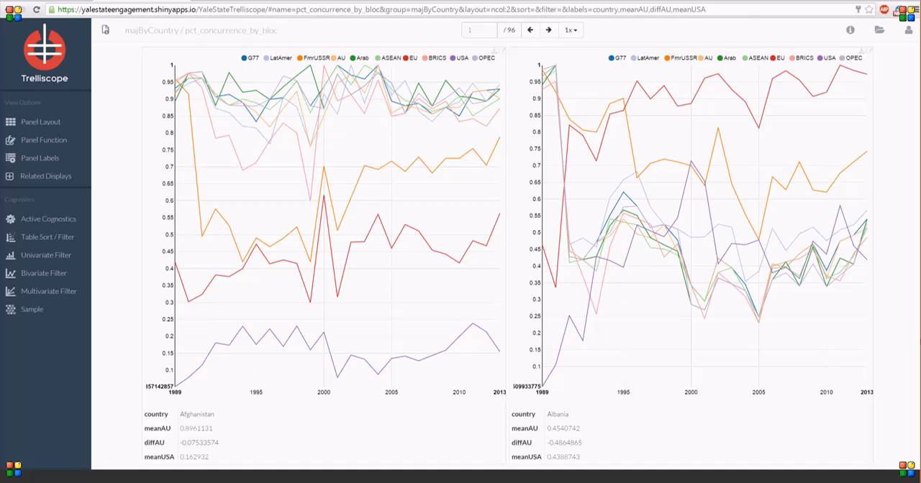
Trelliscope Demo

Slide 12





Text Analysis Objective
Notes:
Following the two previous analyses, which informed our understanding of country and bloc behavior, text analysis will allow us to understand the specifics about their priorities. Using language (from speeches, resolutions, statements, working papers, etc.) as data, text analysis allows us to understand what priorities are held by different countries, blocs, and regions of interest, and how these priorities have changed over time.
This in-depth analysis will allow us to answer the questions, “How have the priorities of UN blocs and specific countries changed over time?”
For state: “How can we use this information to achieve our goals?”
[former text of slide: “To gain a deeper understanding of priorities of countries and blocs of interest by looking at language in official statements.”]

Slide 13
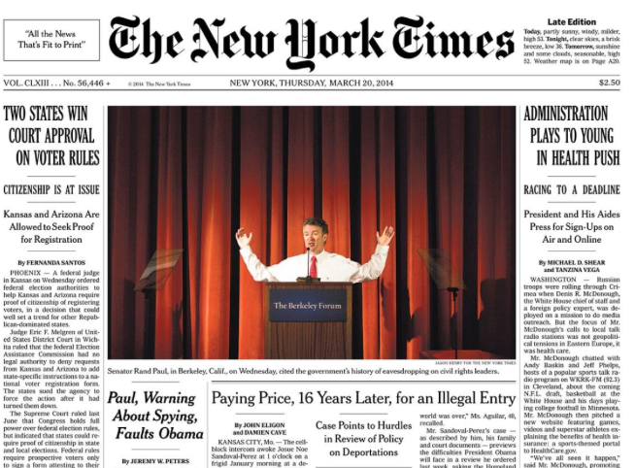
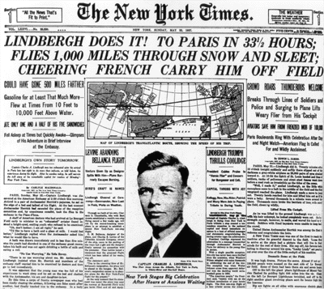
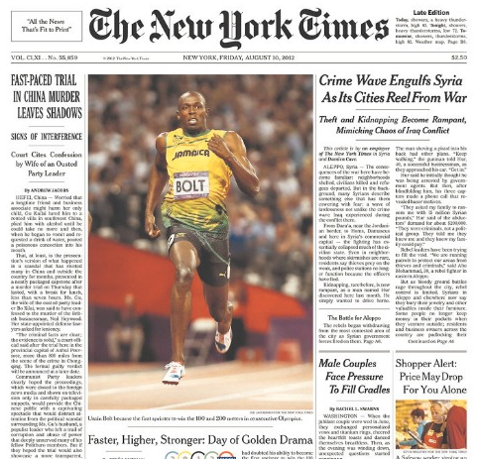
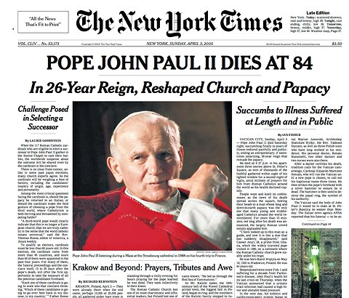
LDA Analysis
Notes:
We use a technique called Latent Dirichlet Allocation that allows us to [two or three words from Dr. Bayesian’s language]. -->next slide

Slide 14

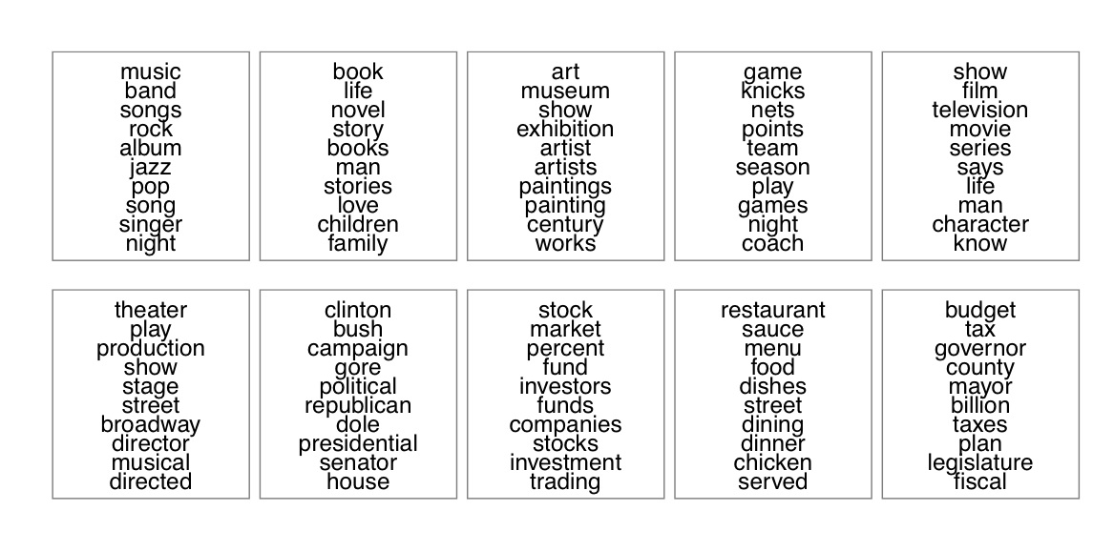
LDA Analysis

Slide 15

LDA Analysis
climate
change
consumption
production
disaster
risk
resource
reduction
waste
natural
law
rule
institution
governance
society
peace
conflict
violence
peaceful
public
private
sector
source
investment
financing
world
oda
bank
finance
income
water
sanitation
target
ecosystem
area
focus
resource
management
food
service
social
employment
protection
work
decent
worker
youth
people
age
labor
woman
gender
equality
girl
access
right
equal
empowerment
violence
discrimination
city
urban
local
settlement
government
human
service
urbanization
rural
transport
health
target
disease
universal
death
mortality
access
coverage
care
surgical
food
agriculture
security
nutrition
land
system
production
forest
agricultural
hunger

Slide 16
SDG Priority Issues
Employment
Global Health
Development Finance
Food Security
Urbanization
Gender Equality
Resource Management
Governance
Climate Change
Notes:
Our LDA Analysis produced eight clear topics that are priority issue areas in the SDG discussion. Using a corpus of 1,387 statements from the Sustainable Development Goal negotiations, with approximately 750,000 words
Now that we have identified these main topics, we can apply them to bloc-level and country-level documents to see how these different parties prioritize these issues.

Slide 17
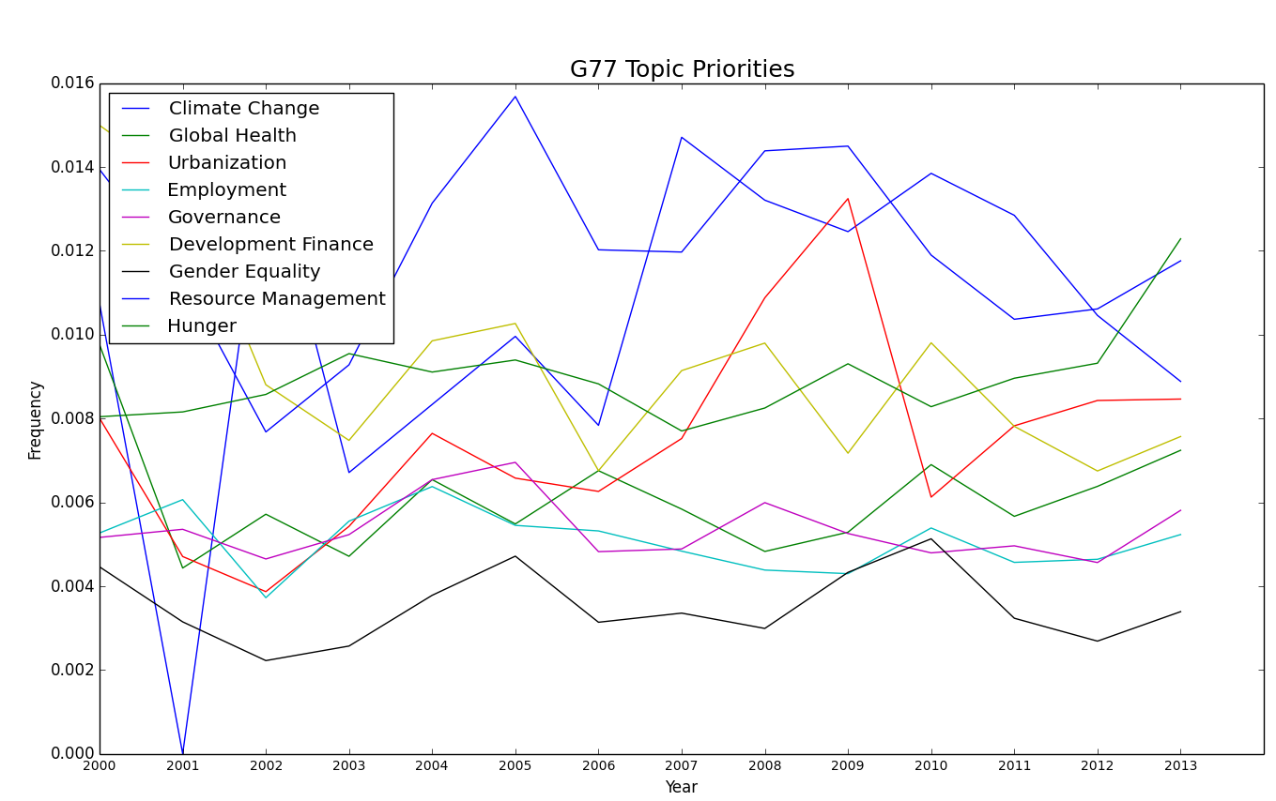
G77 on SDG Topic Priorities
Notes:
For example, how does the G77 prioritize food security, gender equality, and climate change?
Here, we can see that when the 132 members of the G77 act as a group, they prioritize: …
Now, let’s zoom in even further and see if individual countries in the G77 prioritize these issues in the same way, for example with India.

Slide 18
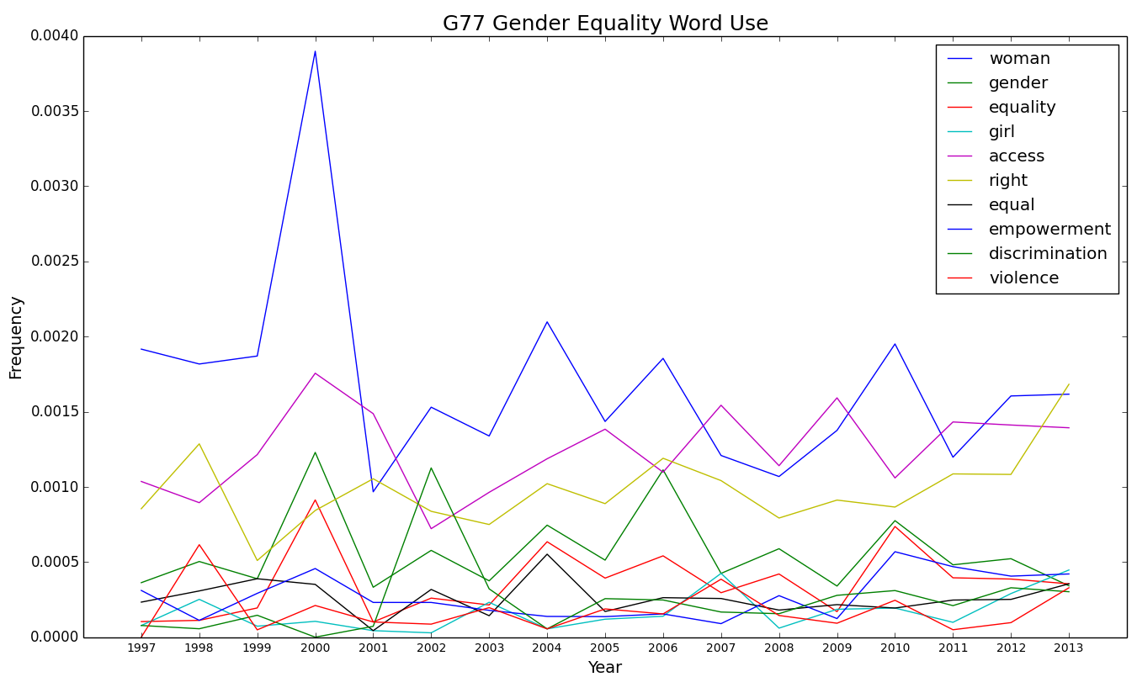
G77 on Gender Equality
Notes:
For example, how does the G77 prioritize food security, gender equality, and climate change?
Here, we can see that when the 132 members of the G77 act as a group, they prioritize: …
Now, let’s zoom in even further and see if individual countries in the G77 prioritize these issues in the same way, for example with India.

Slide 19
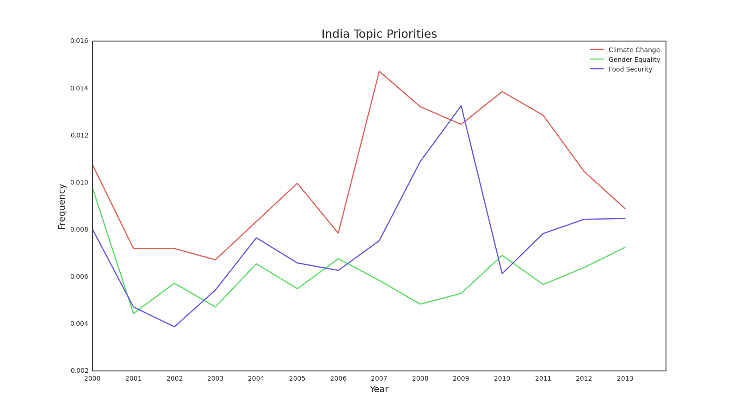
India on SDG Topic Priorities
Gender Equality
Climate Change
Food Security
Notes:
Here, we decided to look at the topics of climate change, gender equality, and food security. We can see that India focuses on gender equality substantially more than food security and climate change. Given how infrequently India discusses climate change in its documents, State can anticipate that India might be a more difficult ally in discussions on that particular topic. But, India might be a great partner in discussions on gender equity.
Now, we’re going to show you how our LDA analysis allows us to zoom in as far as individual word use for a given topic to understand how discourse on these SDG issue areas have changed over time.
We saw that while India considers gender equality a high priority issue, the G77 as a whole does not. Let’s take a look at what is being discussed in the G77’s discussion of gender equality, and how that has changed over time.

Slide 20
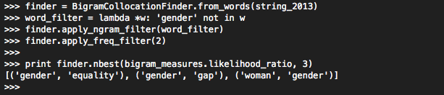
G77 Collocations
Collocations are words that frequently appear in close proximity.
Determined through probability calculations
Describe topics and contexts related to a search term
Show how dialogues around particular terms have changed over time

Slide 21
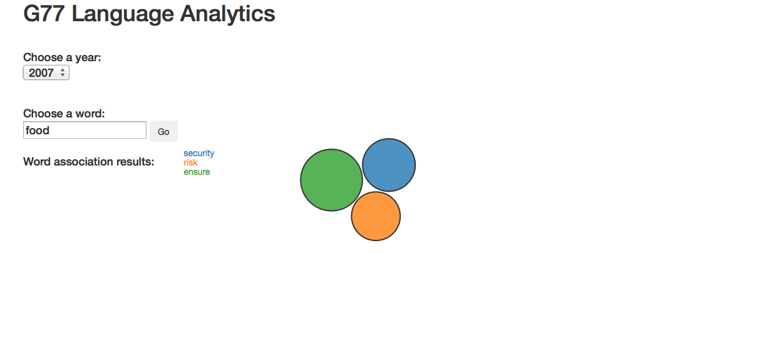
G77 Collocations: Food

Slide 22
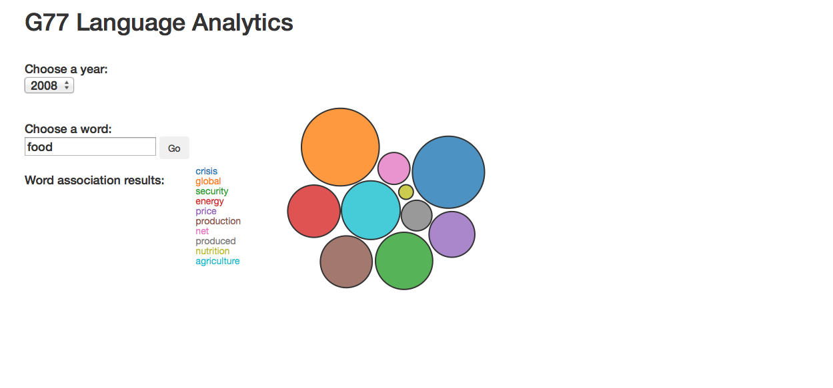
G77 Collocations: Food

Slide 23
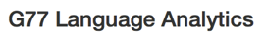
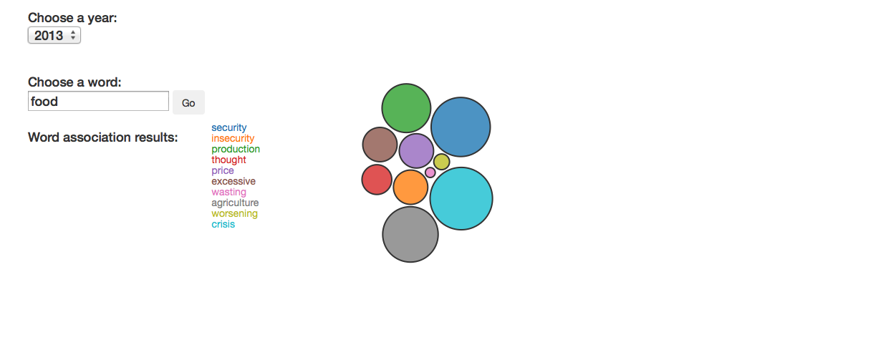
G77 Collocations: Food
Notes:
combines Python and JavaScript through Tangelo, a platform sponsored by the DARPA XDATA program

Slide 24
G77 Collocations: Equality

Slide 25
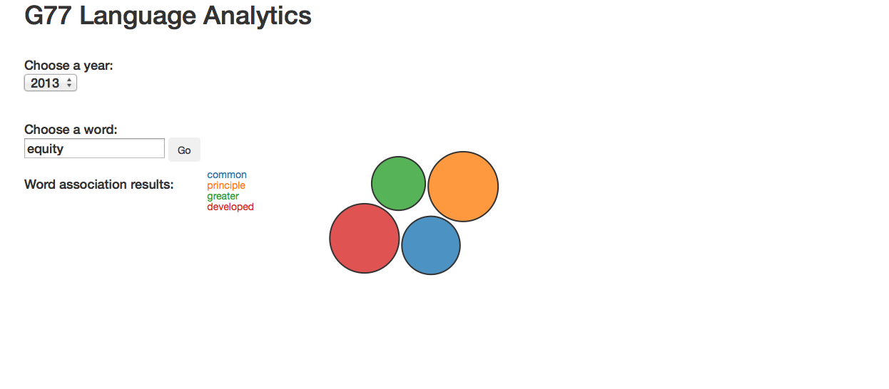
G77 Collocations: Equity

Slide 26
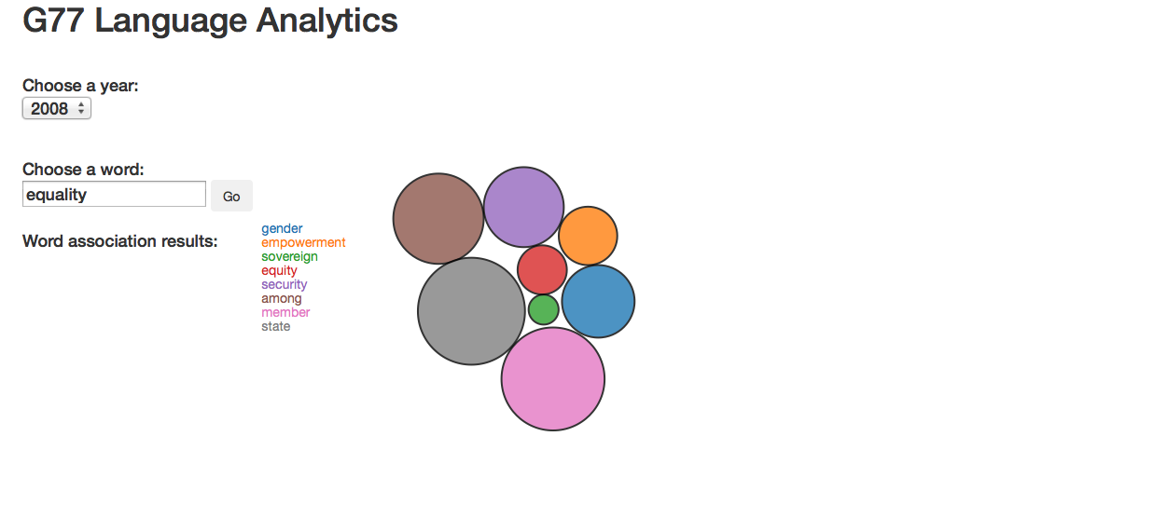
G77 Collocations: Equality

Slide 27
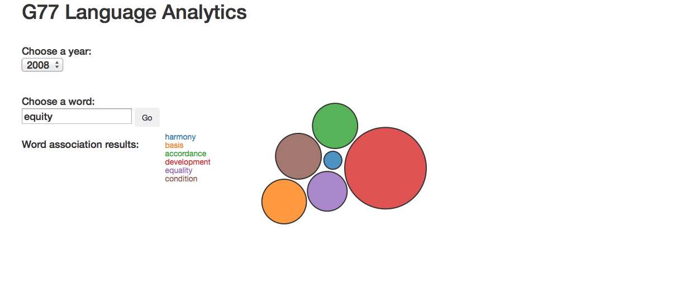
G77 Collocations: Equity

Slide 28
Conclusion
1
2
3
Notes:
Name the tools, but don’t describe them. Just say that we have used both traditional and innovative data.
Voting Cohesion Matrix
Trelliscope Display
Text Analysis

Slide 29
Special Thanks
Joe Cassidy
Maryum Saifee
Professor Casey King
Ben Johnson
Ryan Hafen
Owais Gilani
US Department of State
Yale Affiliates

